Slide 1
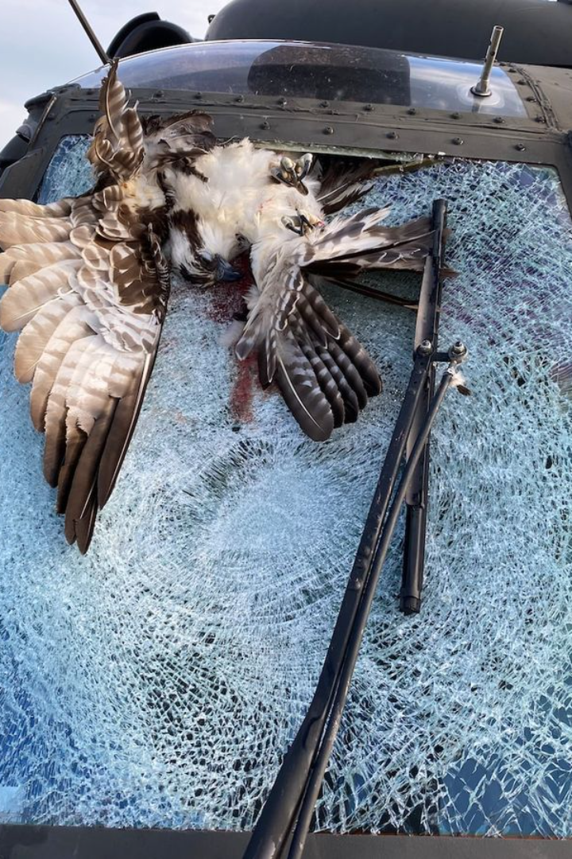
Introduction to Bird Strikes
Bird strikes pose a threat to aircraft safety.

Slide 2
Importance of Data Visualization
1
Clarity
2
Effectiveness
Enhances understanding and decision-making
Communicates complex data with simplicity
3
Engagement
4
Insight
Increases audience interest and impact
Reveals patterns and trends in the data

Slide 3
Overview of Bird Strike Data (2000-2011)
Total Incidents
153,110
Annual Average
13,919
Most Affected Aircraft Type
Small, non-commercial aircraft
Reported Injuries
597

Slide 4
Case Study 1: Bird Strikes at Major Airports
Risk Identification
Impact on Operations
Response Strategies
Identifying high-risk locations and times
Delays and cancellations
Active wildlife management practices
Financial implications
Implement preventive measures
Technological deterrents and repellents

Slide 5



Case Study 2: Impact of Bird Strikes on Aircrafts
Damage Assessment
Safety Risks
Cost Implications
Evaluation of structural damage
Potential impact on flight controls
Repair expenses and downtime costs

Slide 6
Case Study 3: Strategies to Reduce Bird Strikes
Land Use Planning
Intelligent Lighting
Modify habitats near airports
Reduce bird attraction during migration
Acoustic Devices
Repel birds using sound frequencies

Slide 7

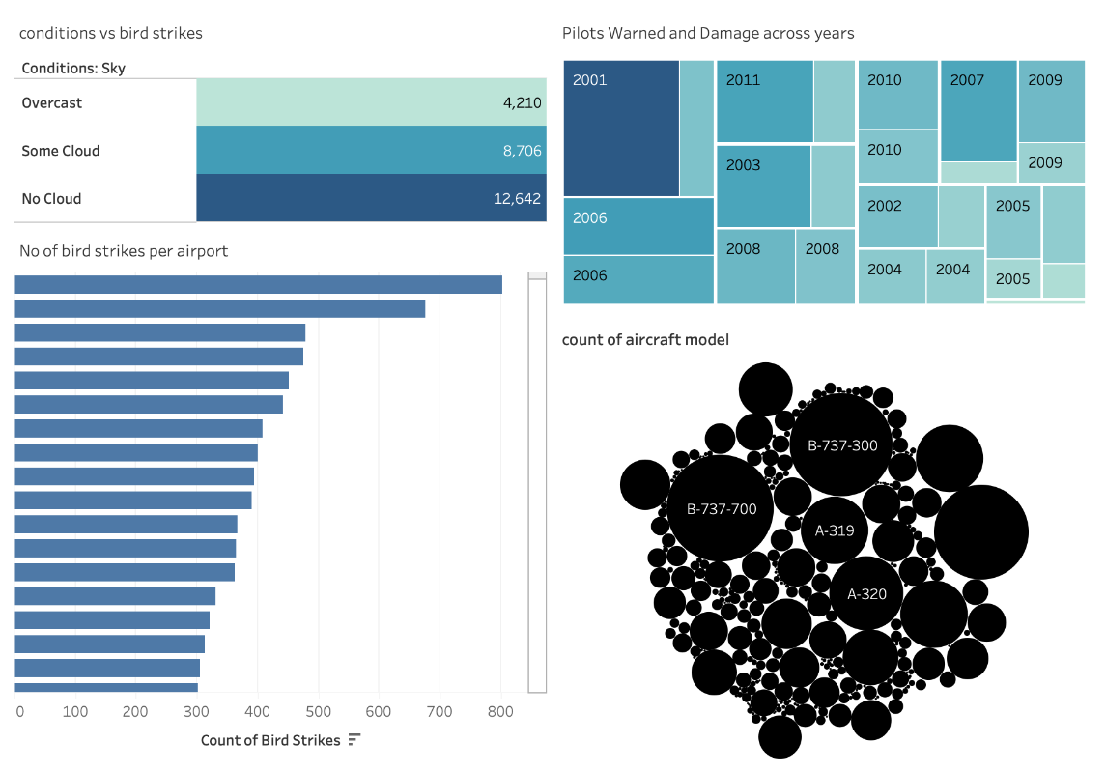
Tableau
Dashboard:

Slide 8
Conclusion and Key Findings
153,110
597
Total Incidents
Reported Injuries

